Slide 1



H U M A N R E V I E W
C O M P U T E R
I N T E R A C T I O N
AR and VR Based FURNITURE STORE
19BCE0874 - Jeet Bangoria 19BCE2498 - Nishant Diggi 19BCE2449 - Anirudh Saxena

Slide 2

Contents
Abstract Literature Review Block Diagram References

Slide 3
Abstract
The aim of our project is to improve the customer experience for buying furniture from an online furniture store. In some cases, after buying furniture customers realise that the furniture size is not suitable for their house or its design doesn’t match with the interior of the house. This project will help the customers visualise that how a particular furniture looks like when kept in their house and will also give the customers an idea if it can be perfectly placed in the desired area of the house. Augmented Reality shall be used to achieve the goal.

Slide 4
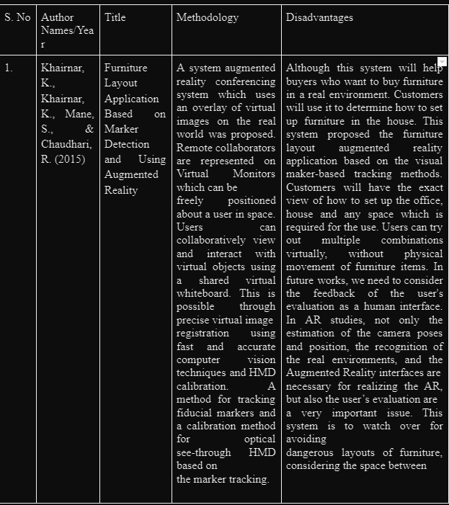
Literature Review

Slide 5
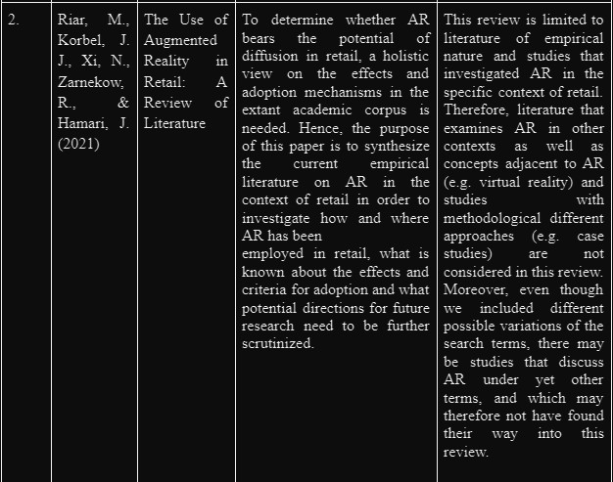
Literature Review

Slide 6
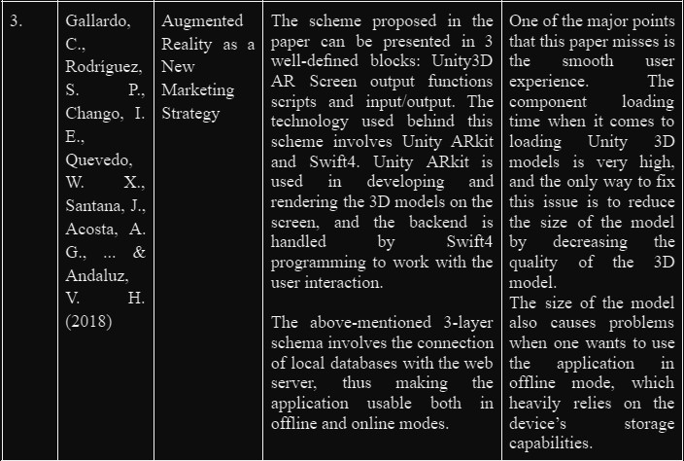
Literature Review

Slide 7
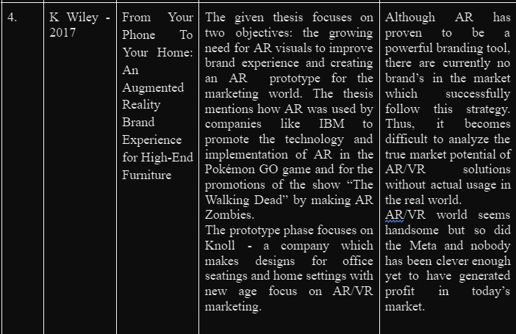
Literature Review

Slide 8
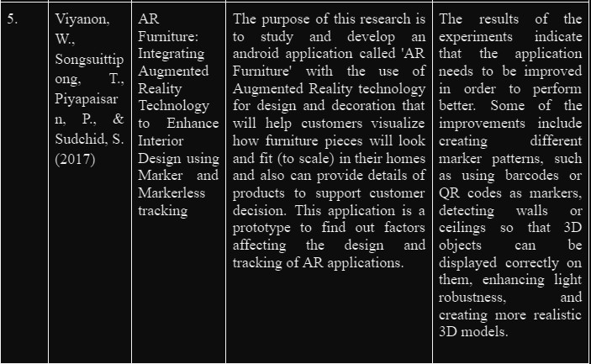
Literature Review

Slide 9
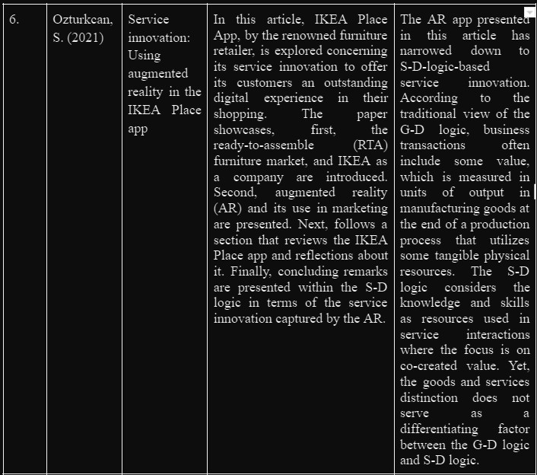
Literature Review

Slide 10
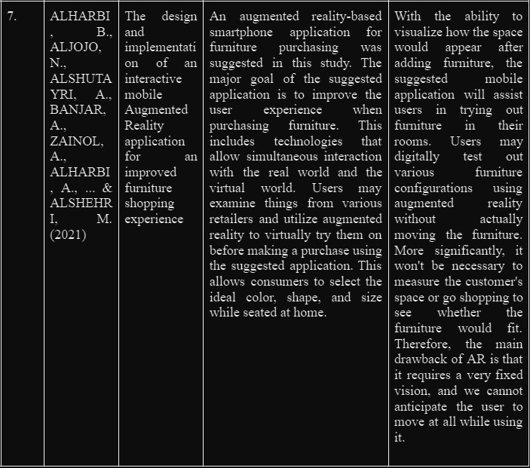
Literature Review

Slide 11
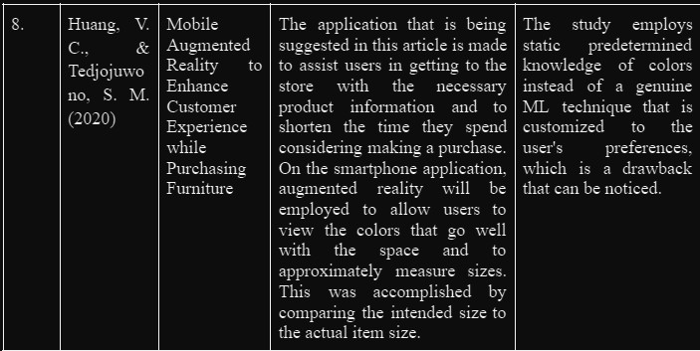
Literature Review

Slide 12
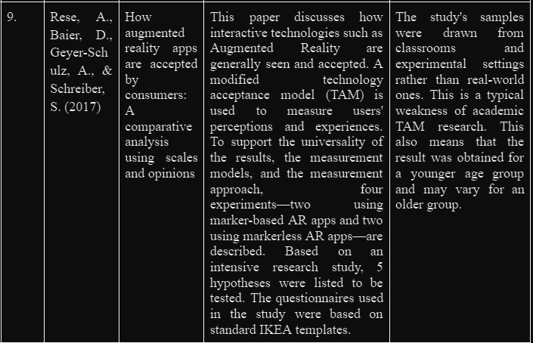
Literature Review

Slide 13
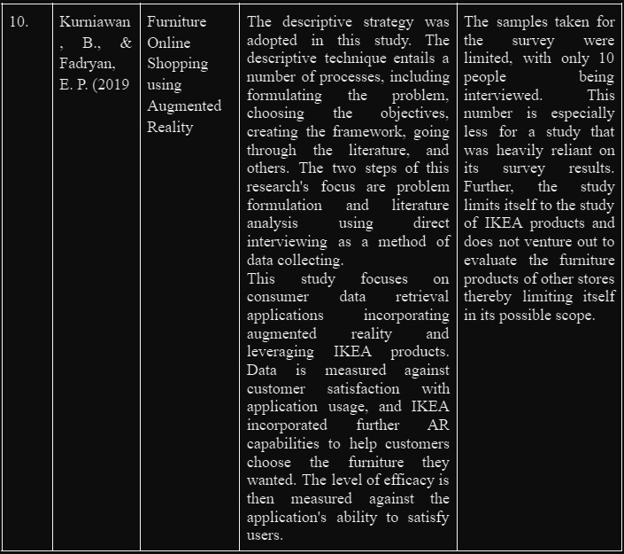
Literature Review

Slide 14
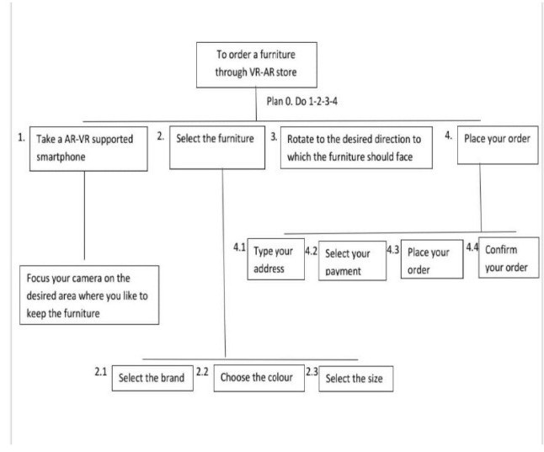
Block Diagram

Slide 15
References
Furniture Layout Application Based on Marker Detection and Using Augmented Reality Khairnar, K., Khairnar, K., Mane, S., & Chaudhari, R. (2015). Furniture layout application based on marker detection and using augmented reality. International Research Journal of Engineering and Technology, 2(7), 540-544.
The Use of Augmented Reality in Retail: A Review of Literature
Riar, M., Korbel, J. J., Xi, N., Zarnekow, R., & Hamari, J. (2021, January). The use of augmented reality in retail: A review of literature. In Proceedings of the 54th Hawaii International Conference on System Sciences (p. 638).
Augmented Reality as a New Marketing Strategy
Gallardo, C., Rodríguez, S. P., Chango, I. E., Quevedo, W. X., Santana, J., Acosta, A. G., ... & Andaluz, V. H. (2018, June). Augmented reality as a new marketing strategy. In International conference on augmented reality, virtual reality and computer graphics (pp. 351-362). Springer, Cham.

Slide 16
References
From Your Phone To Your Home: An Augmented Reality Brand Experience for High-End Furniture
Wiley, K. (2017). From Your Phone To Your Home: An Augmented Reality Brand Experience For High-End Furniture.
AR Furniture: Integrating Augmented Reality Technology to Enhance Interior Design using Marker and Markerless tracking
Viyanon, W., Songsuittipong, T., Piyapaisarn, P., & Sudchid, S.
(2017, July). AR furniture: design using marker and
Integrating augmented reality technology to enhance interior
markerless tracking. In Proceedings of the 2nd International Conference on Intelligent
Information Processing (pp. 1-7).
[6] Service innovation: Using augmented reality in the IKEA Place app
Ozturkcan, S. (2021). Service innovation: Using augmented reality in the IKEA Place app. Journal of Information Technology Teaching Cases, 11(1), 8-13.

Slide 17
References
The design and implementation of an interactive mobile Augmented Reality application for an improved furniture shopping experience
ALHARBI, B., ALJOJO, N., ALSHUTAYRI, A., BANJAR, A., ZAINOL, A., ALHARBI, A., ... &
ALSHEHRI, M. (2021). The design and implementation of an interactive mobile Augmented Reality application for an improved furniture shopping experience. Romanian Journal of Information Technology and Automatic Control, 31(3), 69-80.
Mobile Augmented Reality to Enhance Customer Experience while Purchasing Furniture Huang, V. C., & Tedjojuwono, S. M. (2020, August). Mobile Augmented Reality to Enhance Customer Experience while Purchasing Furniture. In 2020 International Conference on Information Management and Technology (ICIMTech) (pp. 720-725). IEEE.

Slide 18
References
How augmented reality apps are accepted by consumers: A comparative analysis using scales and opinions
Rese, A., Baier, D., Geyer-Schulz, A., & Schreiber, S. (2017). How augmented reality apps are accepted by consumers: A comparative analysis using scales and opinions. Technological Forecasting and Social Change, 124, 306-319.
Furniture Online Shopping using Augmented Reality
Kurniawan, B., & Fadryan, E. P. (2019). Furniture Online Shopping using Augmented Reality.

Slide 19




Thank You!

